Slide 1
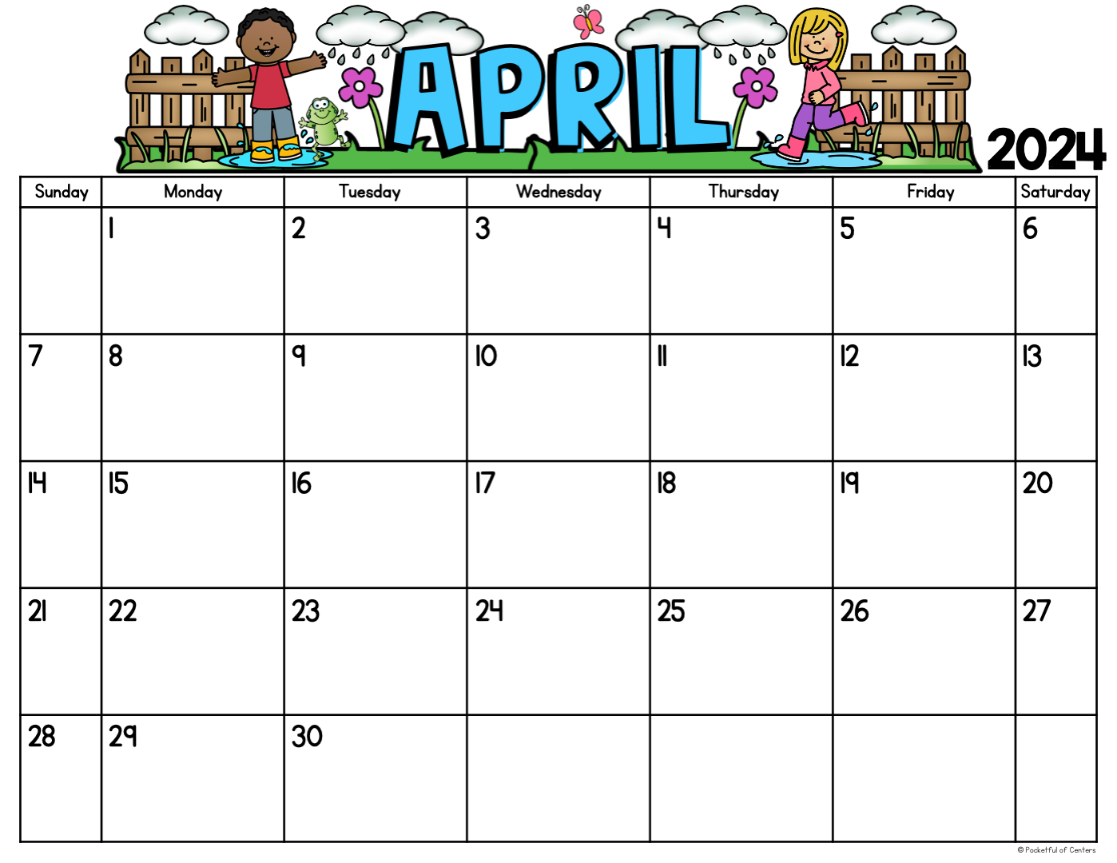
Value of the Month: RESPECT
Grade 4 and 5 FAST Writing Test
Grades 6-8 FAST Writing Test
End of the 3rd Grading Period
Middle School Tennis Championship @ 9:30 am
No School! Teacher Planning Day!
Beginning of the 4th Grading Period
Grades K-2 FAST Reading Test
Junior
Achievement Day!
8th Grade Book Bout Competition!
Fathers in Education Day!
Grades K-2 FAST Math Test
Take your Child to Work Day!!
Report Cards go home today!

